Slide 1

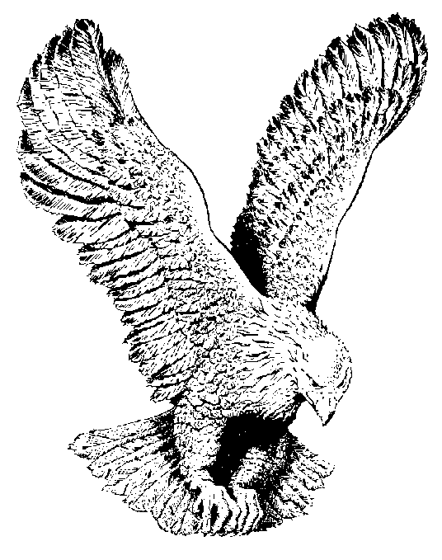
OVERCOMING POWER
Overcoming power
Is what we have today;
Overcoming power
To keep the devil away.
Overcoming power
So we’ll become the Word.
That’s when we’ll leave this sinful earth
And go to meet the Lord.

